Slide 1


LANGUAGE
TRANSLATOR
Name:- Piparva Ravi S.
Roll no.:IT092.
Id:17ITUOS090
Name: Prachi Sanjay Kumar Chaudhari.
Roll no.:IT093.
Id:17ITUTS065

Slide 2
Introduction
Our project is Parser for SQL Select Query. We are making it using lex and yacc.
• Lex is a part of lexical analyzer and
• Yacc is a part of syntax analyzer .
Lex takes source code and produced token this string and Yacc takes token and make Parse tree.

Slide 3
Project Aim
• Our project aim was learning that
➢ how lexical analyzer work
➢ syntax analyzer works.
➢ How can make a simple parser
➢ Our own parser from own rules and parse tree
➢ How parser work with compiler

Slide 4
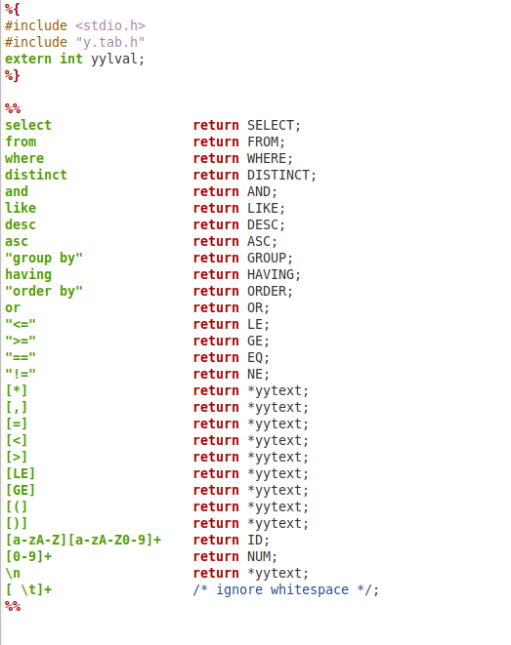
Lex Program

Slide 5
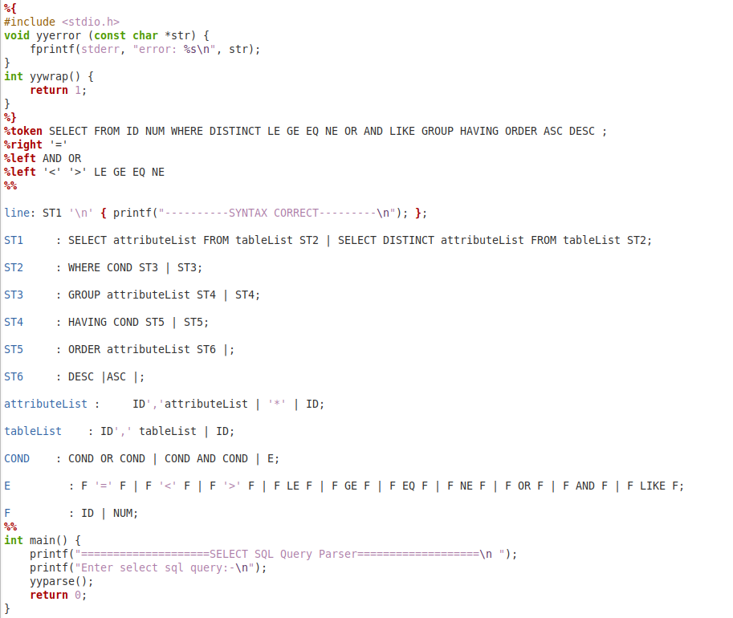
Yacc Program

Slide 6

Compilation Process
1. flex filename.l
2. It will give lex.yy.c file.
3. yacc -d filename.y
4. It will give y.tab.h and y.tab.c file.
5. gcc lex.yy.c y.tab.c -o name
6. It will give name.exe file.

Slide 7

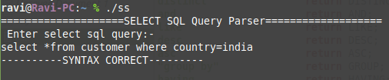

Input Output Scenarios

Slide 8
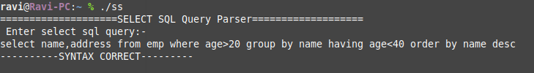


Input Output Scenarios

Slide 9

Thank You!!

